Slide 1

Welcome
Rearchitect your code
towards async/await
Notes:
A warm welcome to this first webinar in the async webinar series.
Today we talk about Async best-practices

Slide 2

Solution Architect
Enthusiastic Software Engineer
Microsoft MVP for systems integration
@danielmarbach
particular.net/blog
planetgeek.ch
Notes:
I’m Daniel, Solution Architect…
I live in central Switzerland. If you want to know more about me listen to episode 77 of developer on fire
You can reach me on twitter under @danielmarbach
I blog on the particular blog and on my personal blog
Subscribe after this webinar

Slide 3
CPU-bound vs IO-bound
Threads and Tasks
Async best-practices
Why async is the future
Goals
target
Notes:
In this webinar we will learn important terminologies
The difference between CPU-bound and IO-bound
The difference between Threads and Tasks
And a few async best-practices

Slide 4
Premise
Notes:
Basic knowledge of async/await in Csharp
Of course there is also reactive programming which has its own benefits and drawbacks, I will focus on Task-based APIs only without involving reactive programming models in this talk

Slide 5
Terminology
Why
WrapUp
Notes:
This webinar is divided into three parts
Terminology
Code and WrapUp including Q&A

Slide 6
cast
The die
is

Slide 7
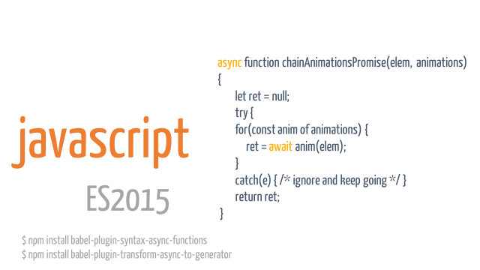
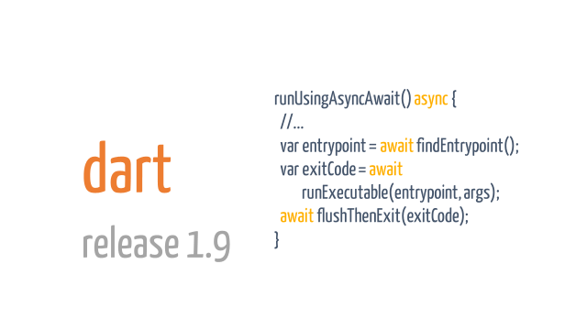
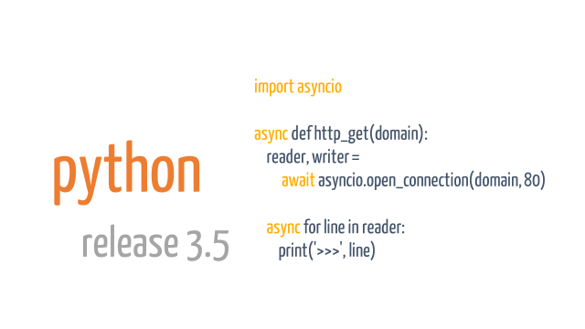

Slide 8
using (var client = new HttpClient()) {
var response = await client.GetAsync("api/products/1");
if (response.IsSuccessStatusCode)
{
var product = await response.Content.ReadAsAsync<Product>();
}
}
httpclient
Notes:
https://msdn.microsoft.com/en-us/library/system.net.http.httpclient.aspx
Only provides asynchronous APIs

Slide 9
var queryable = client.CreateDocumentQuery<Entity>(...) .AsDocumentQuery();
while (queryable.HasMoreResults)
{
foreach(var e in await queryable.ExecuteNextAsync<Entity>())
{
// Iterate through entities
}
}
Azure SDK
Notes:
For legacy reasons:
There are still synchronous APIs provided, but most love goes into asynchronous APIs. Sometimes synchronous APIs behave differently than asynchronous APIs. Bugs get fixed on sync APIs mostly.
Newcomer PaaS services:
Like DocumentDB (except for some parts of the querying APIs) or ServiceFabric have almost only async APIs
https://msdn.microsoft.com/en-us/library/microsoft.azure.documents.client.documentclient_methods.aspx

Slide 10
async function chainAnimationsPromise(elem, animations) {
let ret = null;
try {
for(const anim of animations) {
ret = await anim(elem);
}
catch(e) { /* ignore and keep going */ }
return ret;
}
javascript
ES2015
$ npm install babel-plugin-syntax-async-functions $ npm install babel-plugin-transform-async-to-generator

Slide 11
runUsingAsyncAwait() async {
//...
var entrypoint = await findEntrypoint();
var exitCode = await runExecutable(entrypoint, args);
await flushThenExit(exitCode);
}
dart
release 1.9

Slide 12
import asyncio
async def http_get(domain):
reader, writer = await asyncio.open_connection(domain, 80)
async for line in reader:
print('>>>', line)
python
release 3.5

Slide 13

async
event-driven
Notes:
Async in the real world can be compared to me doing the laundry. I put my dirty clothes into the machine and select the program or timer and let the machine do its work. Until the laundry is done, indicated by a beep of the machine, I can carry on with other things like reading the newspaper, playing with my kid…
So I, the worker, am free until signal indicates external task is done
This is very similar to software
Asynchronous program
dispatches tasks to devices that can take care of themselves, leaving the program free to do something else until it receives a signal that the results are finished
Asynchronous programming should be used for external operations which support event-driven callbacks when they are done.
Usually that is the case for IO-bound work.
For example on windows IOCompletionPorts signal the result of a IO operation back to the initiator of the operation
Async operation can be more efficient, since the worker initiating the work are not blocked.

Slide 14

Task
uniform
Notes:
System.Threading.Task is an abstraction layer which represents both CPU bound and IO-bound operations as a uniformed API
Represents the state and outcome of an asynchronous operation executed now, later or never
This is very similar to washing clothes.
If Task represents an IO-bound operation then, we could compare it to

Slide 15
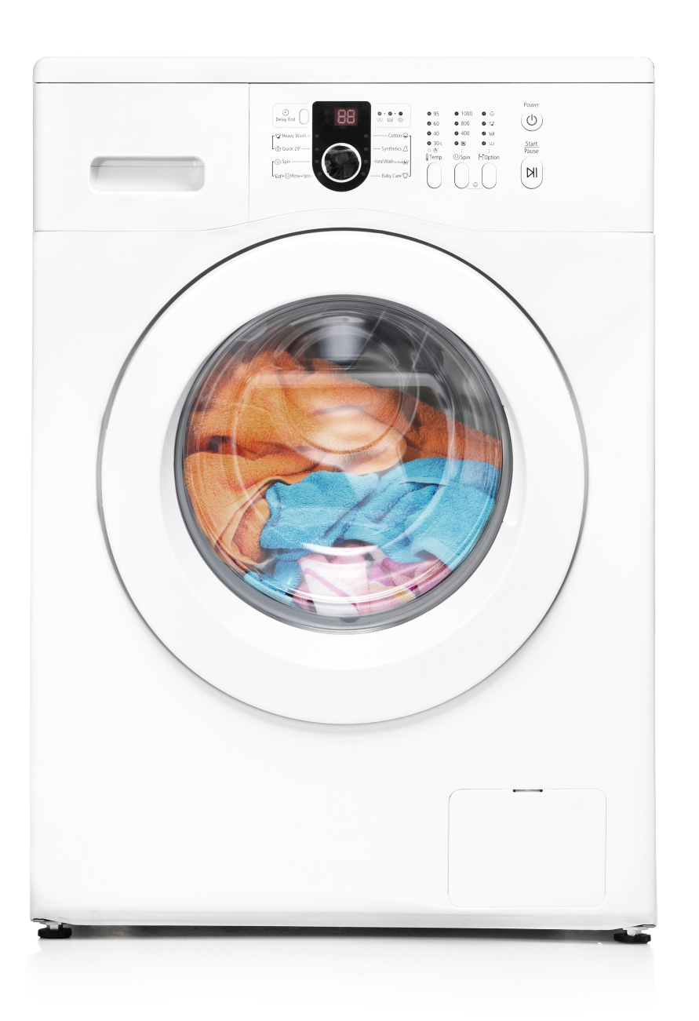
Task
IO-bound
Notes:
The laundry machine
So the state of the task representing the laundry machine would be running, not running, completed
The outcome should be clean clothes
I can late start the machine with a timer, or the machine can decide to run a health check before the process starts
It is also possible that because of failures the machine never starts
Or even more likely my wife cancels the process because yet again I’ve chosen the wrong temperature
The CPU-bound task

Slide 16

Task
CPU-bound
Notes:
Can be compared to me doing the laundry manually
No matter whether the task is IO or CPU bound, Threads are the workers responsible for getting Tasks done that are scheduled
But with CPU bound tasks the worker thread is blocked
So that means a thread can only handle one CPU-bound task at a time
In contrast
A thread can handle multiple IO-bound tasks concurrently

Slide 17
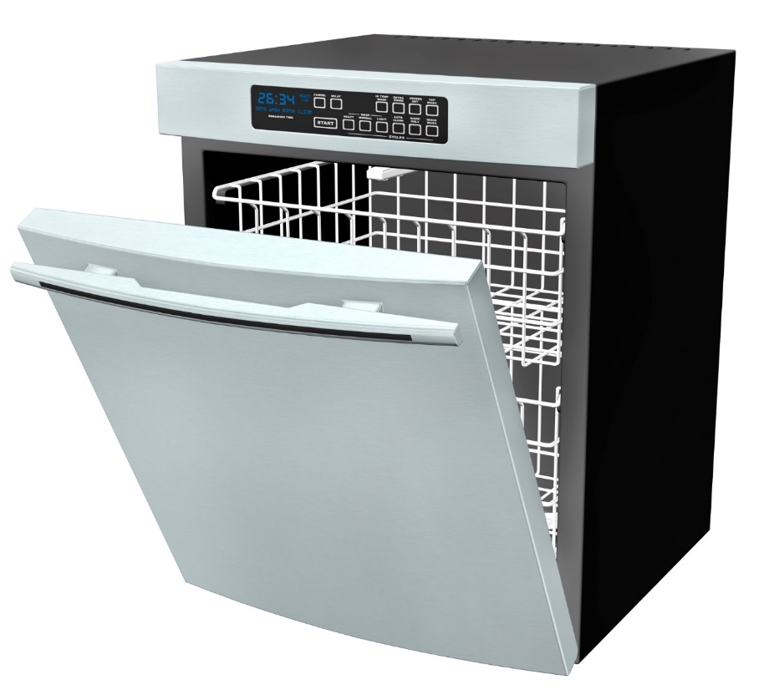

concurrent
concurrent
concurrent
concurrent
concurrent
interleaved
Notes:
Concurrent is like me while doing the laundry, I walk into the kitchen, put my newspaper away, fill the remaining dishes into the dishwasher and start the dishwasher and go back to reading the newspaper
In software this means
There is a coordinator called Scheduler which deals usually on a single thread with multiple concurrent work items
These work items can be interleaved
Depending on the scheduler work can still be distributed over threads and processors, but doesn’t have to

Slide 18
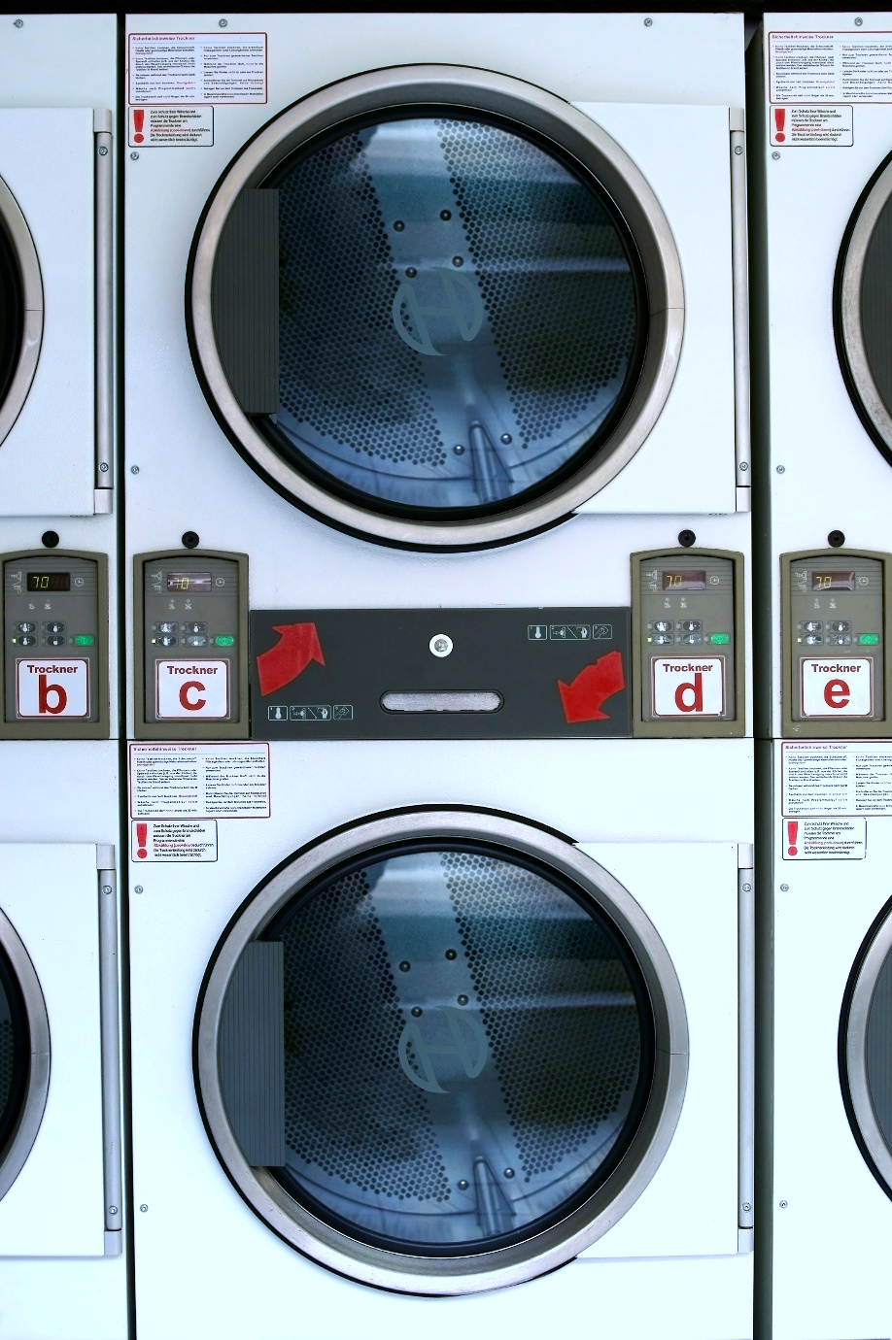
parallel
parallel
simultaneous
Notes:
Parallel can be compared to the laundromat. Multiple people can do their laundry in parallel.
In software this means
A parallel program means
Independent subexpression are evaluated simultaneously on different processors or thread
Goal: Finish computation faster
Ideally suited for CPU bound work such as sorting data in-memory, filter data
To be able to benefit from parallelism the problem needs to be dividable into induvial sub items which can be worked on independently
You can achieve parallelism using concurrency constructs but not the other way around

Slide 19

Continuation
function
Notes:
When the laundry is done, I can take out the clothes and dry them in the dryer. So drying is a continuation of the laundry.
In asynchronous programming a continuation is
A function that is scheduled for execution after its prerequisite function has completed

Slide 20
await cleanLaundry;
await dryLaundry;

Slide 21
Recap
Use async Task instead of async void
Async all the way, don’t mix blocking and asynchronous code
best-practices

Slide 22
viral
Async / await
is

Slide 23
but

Slide 24
It kicks your
servers
butt
Notes:
In a server app, every thread is worth freeing up. You can always use a free threadpool thread because more work is coming. On a server app, the comparison is between asynchronous code and parallel code - and with that comparison, async blows parallel out of the water.
In particular, in a server app, async uses much less memory allocation (and that's where most of the scalability benefits come from): the amount of memory saved by freeing up a thread (and its massive stack) dwarfs the amount of memory used for all the async structures combined. Interestingly, if you examine each request in isolation, it would actually be (slightly) slower than the synchronous version (since there is the extra kernel transition, etc); but the scalability more than makes up for it IMO.
Also, from the server perspective, async can handle bursting traffic better; the IOCP is "always-on", so to speak. In contrast, the thread pool has a limited thread injection rate.
So, if you compare asynchrony to synchrony - just looking at one method or one request - then synchrony makes more sense. But if you compare asynchrony to parallelism - looking at the server as a whole - then asynchrony generally wins.

Slide 25
NServiceBus
26 times
Azure Service Bus
6 times
Azure Storage Queues
MSMQ
3 times
more message throughput
Notes:
Attention the results may vary drastically depending on the azure latency and the hardware used on prem for MSMQ.
And this is only raw throughput measured. Everything else is also asynchronous like persistence, file transfers and so on. We also see much better ressource usage like using less threads more efficiently. Less CPU usage while high IO usage…

Slide 26
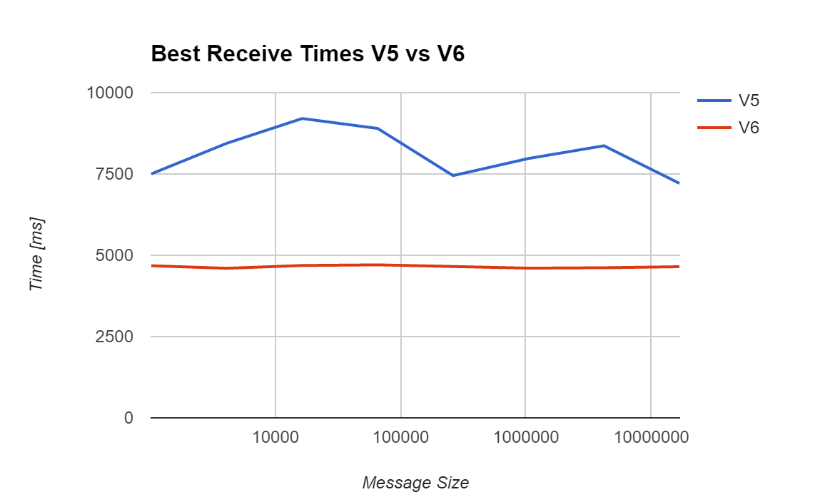
NServiceBus.SqlServer

Slide 27
Identification
Discover
Obstacle
Bring it together
Notes:
I show you a four-phased approach to evolving your code-base towards async/wait. In the identification phase, we classify the components which would benefit from async/await. In the exploration phase, we discover potential road blockers which might hinder the async/await adoption.
In the obstacle phase, we learn to redesign parts of the code to remove the previously identified road blockers. In the bring-it-together phase, we gradually move the components which benefit the most from async/await to a full asynchronous API. Small steps. No Big Bang.

Slide 29

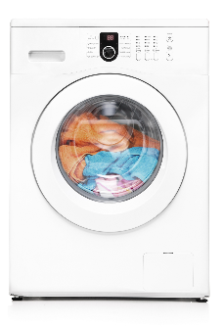

Worker Threadpool
IO Threadpool
Task.Run
Task.Factory.StartNew
Parallel.For
Parallel.ForEach
await iobound
iobound.FireForget()

Slide 33
Terminology
Why
WrapUp
Notes:
Before we dive deep into code I’m going to talk important terminologies.

Slide 34
Use Task.Run, Factory.StartNew for CPU-bound work Use Task directly for IO-bound work
Use async Task instead of async void
Recap
reminder

Slide 35
Recap
Libraries and frameworks should use ConfigureAwait(false)
Async all the way, don’t mix blocking and asynchronous code
reminder

Slide 36
Slides, Links…
github.com/danielmarbach/RearchitectTowardsAsyncAwait
Notes:
Questions that can be answered in blog posts

Slide 37
Q & A
await

Slide 38
Thanks
Notes:
Thank you very much for listening and see you next time

